Slide 1

ECE 220 Computer Systems & Programming
Lecture 2: Input/Output Abstractions
January 17, 2019
Notes:
ECE Main Slide

Slide 2
Outline
Section 8.1-8.4 of Patt and Patel
I/O principles
Input from keyboard
Output to monitor (reading assignment)
Key concepts
Memory mapped I/O
Asynchronous and synchronous communication

Slide 3
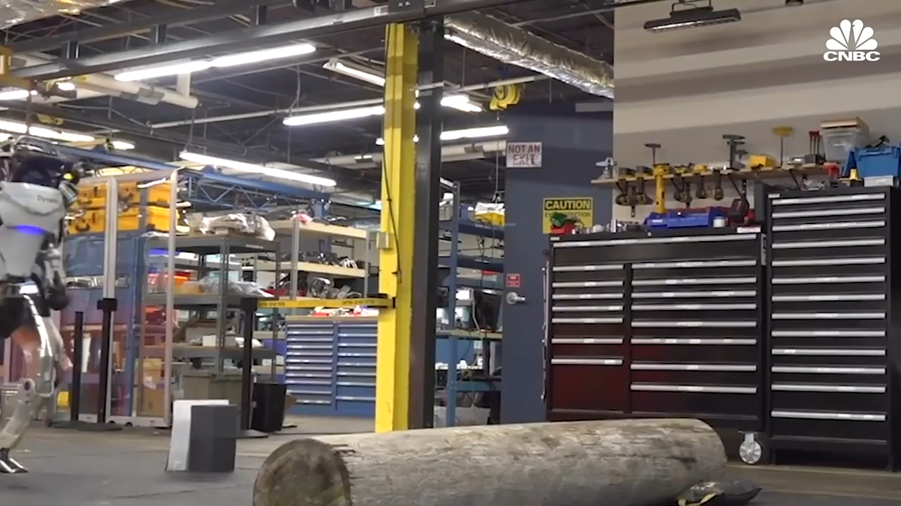
Humanoid Robot

Slide 4
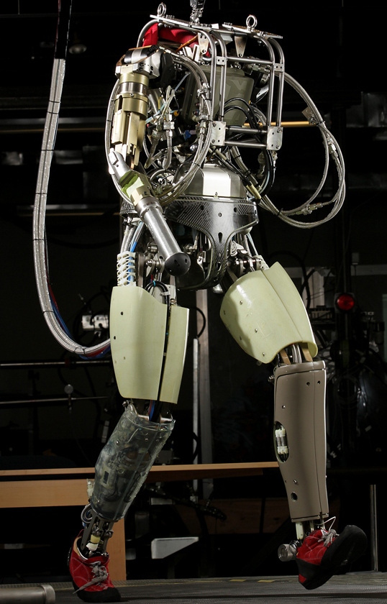
I/O with the physical world
Sensors: cameras, RADARS, IMUs, Gyros
CPU & Memory
Controlling bipedal gait,
Image processing, obstacle detecting, path planning, control, …
Actuators: servo motors, hydraulics, steering
CPU and Memory
Control
Unit
PC, IR, FSM
Processing Unit
R0 … R7
ALU
Memory
Program
Data

Slide 5
Complete system
Many more examples
Autopilot
Antilock brakes
…
Autonomous cars
UAVs/Drones
Space rovers
Smart pacemakers
Powerplants
…
Sensors: cameras, RADARS, IMUs, Gyros
CPU & Memory
Controlling bipedal gait,
Image processing, obstacle detecting, path planning, control, …
Actuators: servo motors, hydraulics, steering
CPU and Memory
Control
Unit
PC, IR, FSM
Processing Unit
R0 … R7
ALU
Memory
Program
Data

Slide 6
I/O Layout
Keyboard
How to connect a keyboard to LC3?
LC-3

Slide 7
how should we connect a keyboard to the computer?

Slide 8
LC3 Memory: Memory mapped device registers
Address | Contents | Comments
x0000 |  | ;system space
…
x3000 |  | ; user space
 |  | ; programs
 |  | ; and data
…
xFE00 |  | ; Device registers maps
…
xFFFF
These are the memory addresses to which the device registers (KBDR, etc.) are mapped
The device registers physically are separate circuits from the memory
xFE00 KBSR
xFE02 KBDR
xFE04 DSR
xFE06 DDR

Slide 9
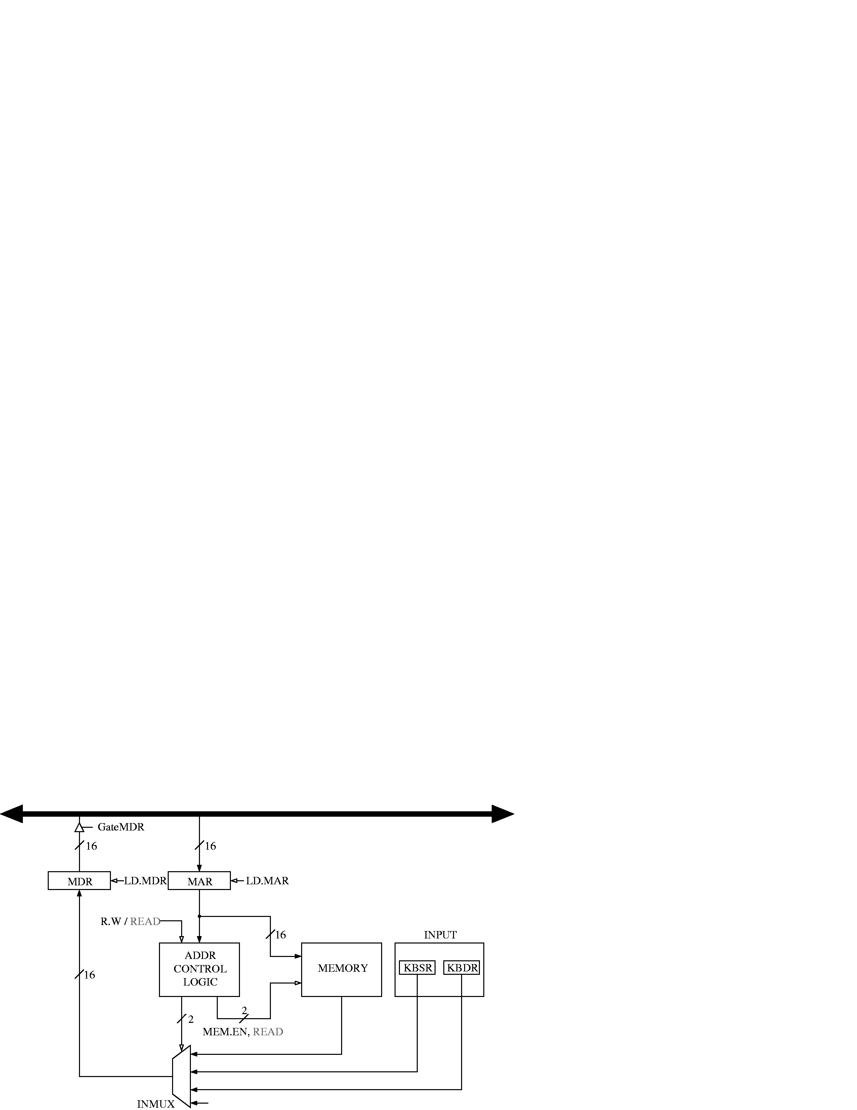
Circuit for memory mapped Inout
Conventional memory access: LD DR, addr
MAR←addr
MDR←MEM[MAR]
DR←MDR
Memory-mapped input access: LD DR, xFE02
MAR←xFE02
MDR←KBDR
DR←MDR
0
1
2

Slide 10
Reading Input (first attempt)
keyboard data
15
8
7
0
KBDR
15
14
0
START LDI R1, KBDRAdd ; Read from KBD
….
BRnzp START
KBDRAdd .FILL xFE02 ; Address of KBDR
Does this work?

Slide 11
Handshaking using KBDR and KBSR
When a char is typed by user in the keyboard
Its ASCII code is placed in KBDR[0:7]
KBSR[15] is set to 1 (ready bit)
Keyboard is disabled, i.e., any further keypress is ignored
When KBDR is read by CPU
KBSR[15] is set to 0
Keyboard is enabled
This is part of the keyboard Hardware.

Slide 12
Reading Input the right way
This is how TRAP x20 = GETC works!
keyboard data
15
8
7
0
KBDR
15
ready bit
14
0
KBSR
START LDI R1, KBSR_ADDR ; Test for
BRzp START ; character input
LDI R0, KBDR_ADDR
BRnzp NEXT_TASK ; Go to the next task
...
KBSR_ADDR .FILL xFE00 ; Address of KBSR
KBDR_ADDR .FILL xFE02 ; Address of KBDR

Slide 13
I/O Layout
Display
How to connect a display to LC3?
LC-3

Slide 14
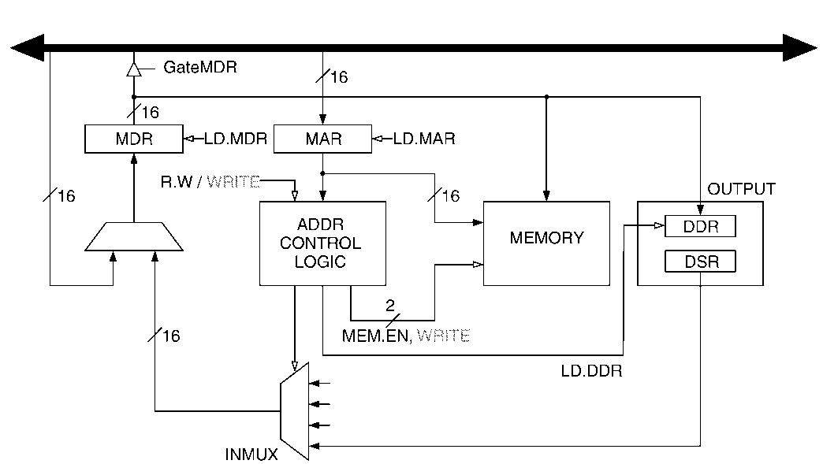
Circuit for memory mapped output
Conventional write: ST SR, addr
MAR←addr
MDR←SR
Mem[MAR]←MDR
Memory-mapped input access: ST SR, xFE06
MAR←xFE06
MDR←SR
DDR←MDR
Problem of asynchrony, again!

Slide 15
Handshaking using DDR and DSR
When monitor is ready to display another char
DSR[15] is set to 1: (ready bit)
When new char is written to DDR
DSR[15] is set to 0
Any other chars written to DDR are ignored
DDR[7:0] is displayed
This is part of the display hardware.

Slide 16
Writing TRAP x21
This is how TRAP x21 = OUT works!
output data
15
8
7
0
DDR
15
ready bit
14
0
DSR
START LDI R1, DSR_ADDR ; Test for
BRzp START ; character input
STI R0, DDR_ADDR
BRnzp NEXT_TASK ; Go to the next task
...
DSR_ADDR .FILL xFE04 ; Address of DSR
DDR_ADDR .FILL xFE06 ; Address of DDR

Slide 17
Exercises
Write code for PUTS (display a stored string)
Write code for ECHO (read a char and display it)
Read Interrupt-driven I/O

Slide 18
Summary of concepts
Memory mapped I/O (extra hardware for flexibility and convenience of programming)
Asynchrony
Polling

